Slide 1
FINAL PROJECT
ReDI School of Digital Integration

Slide 2
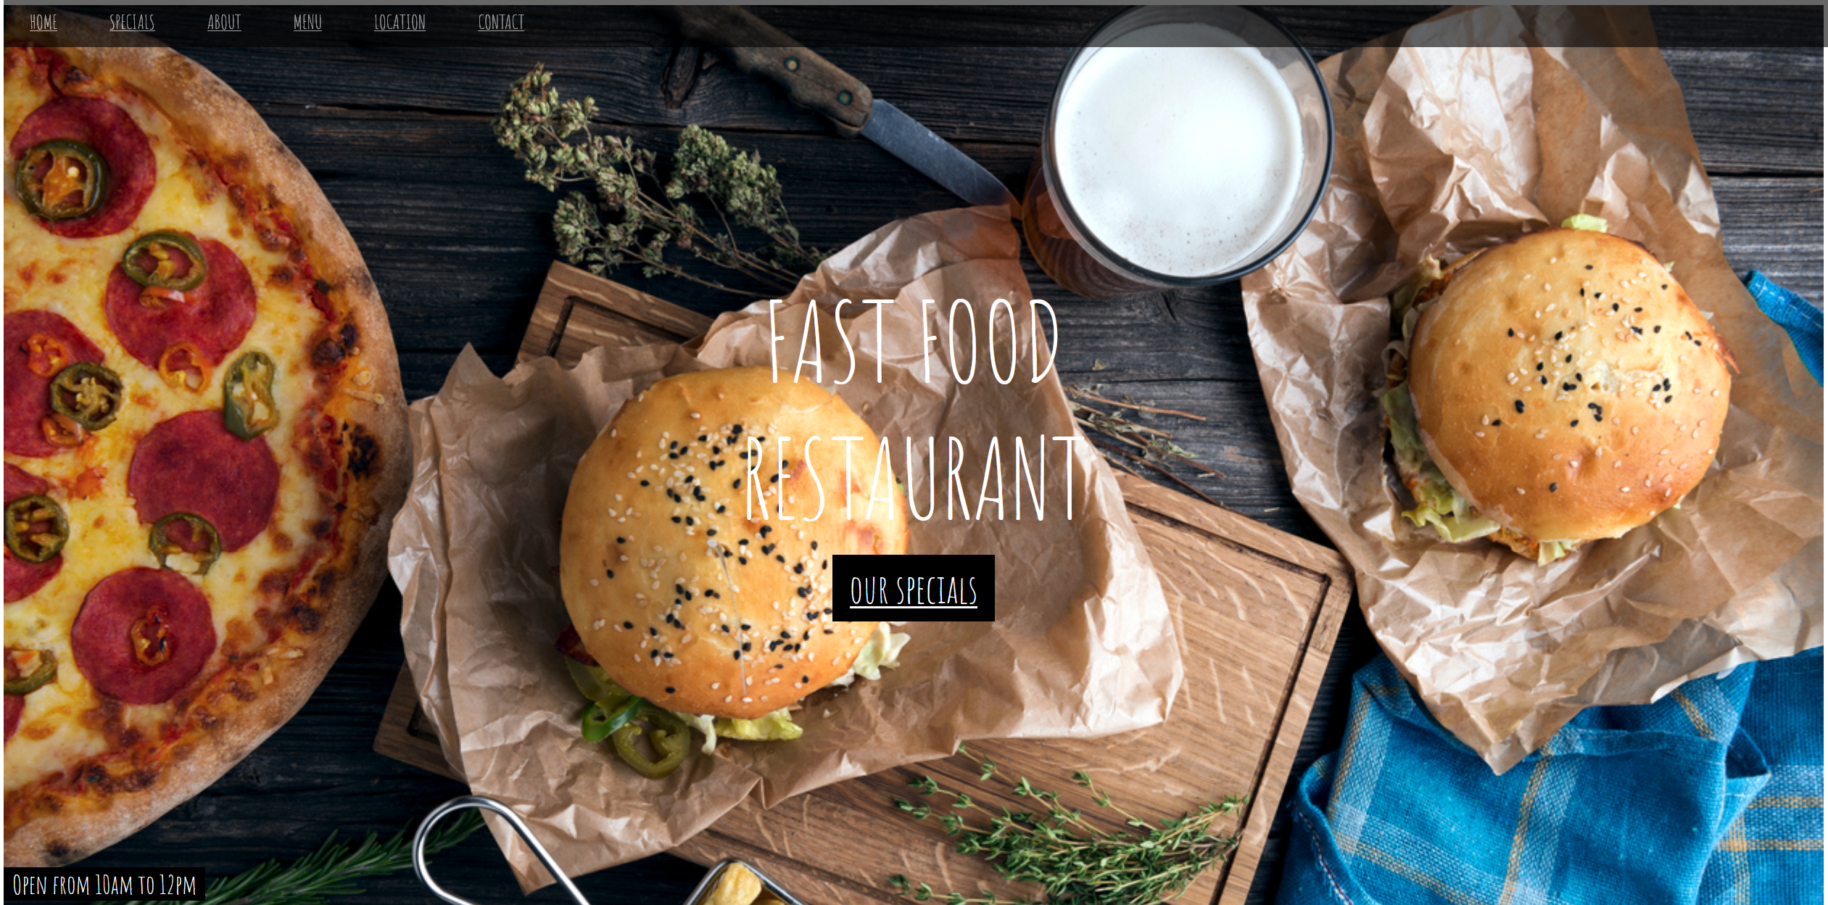

Restaurant Website
COURSE: Front End Development
Presenter: Jugal Vaidya

Slide 3
Restaurant Webpage
Course: Front-end web development Intermediate
Batch: Summer 2022 (March – June)
Final project Title: Restaurant Website (Fast food Restaurant)
Tools: Mozilla Browser, Visual Studio Code
Structure: HTML-5, Styling: css3, Programming lang: Javascript
Version control: Github
Github Link→ https://github.com/jugalvaidya/Restaurant_webpage

Slide 4
Home

Slide 5
Thank you / Danke!
Jugal Vaidya
Front-end Development Intermediate

